Slide 1
PC Crash – 15 mph Steer Comparison
Original PC Crash Model
Pycrash CG height = 2 ft

Slide 2
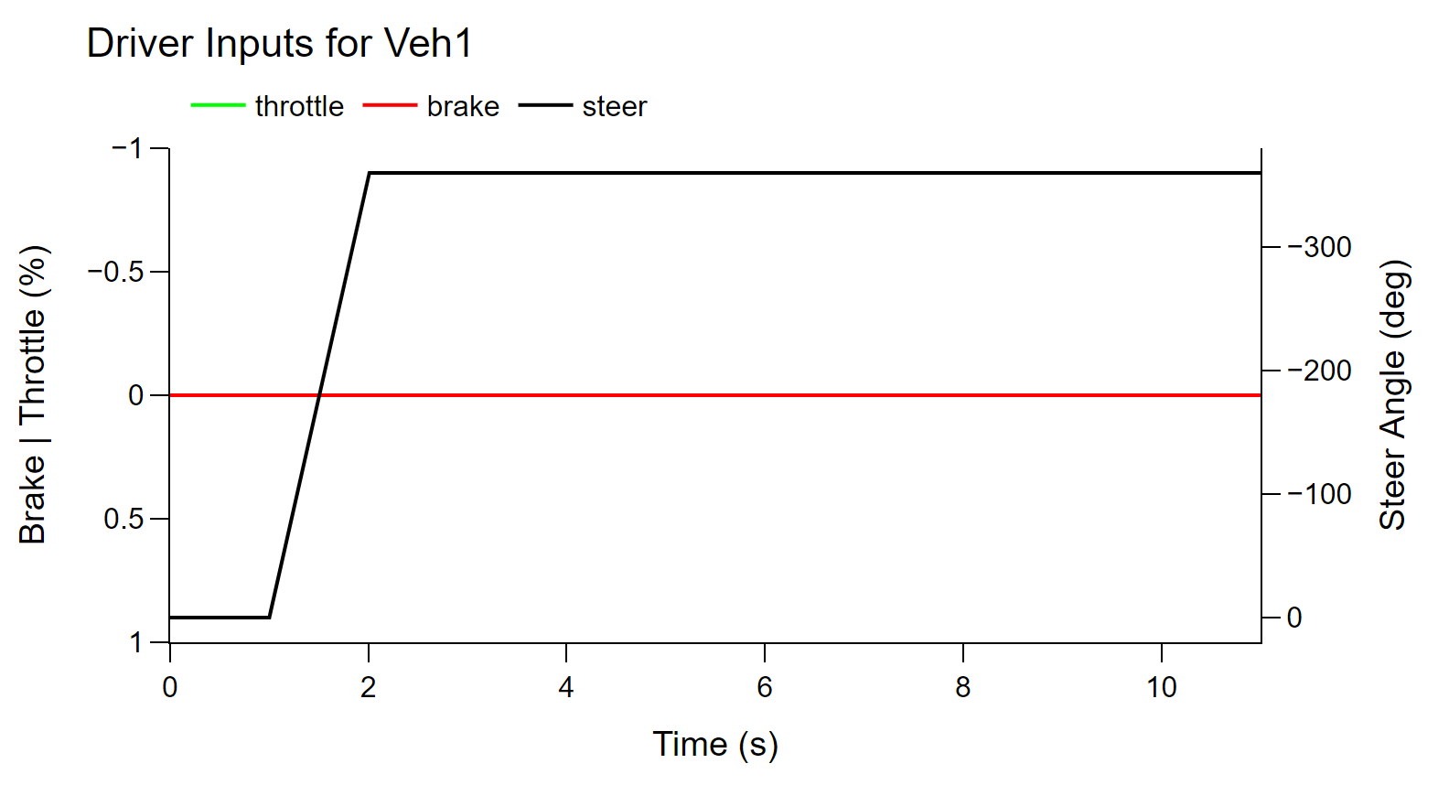
Inputs

Slide 3
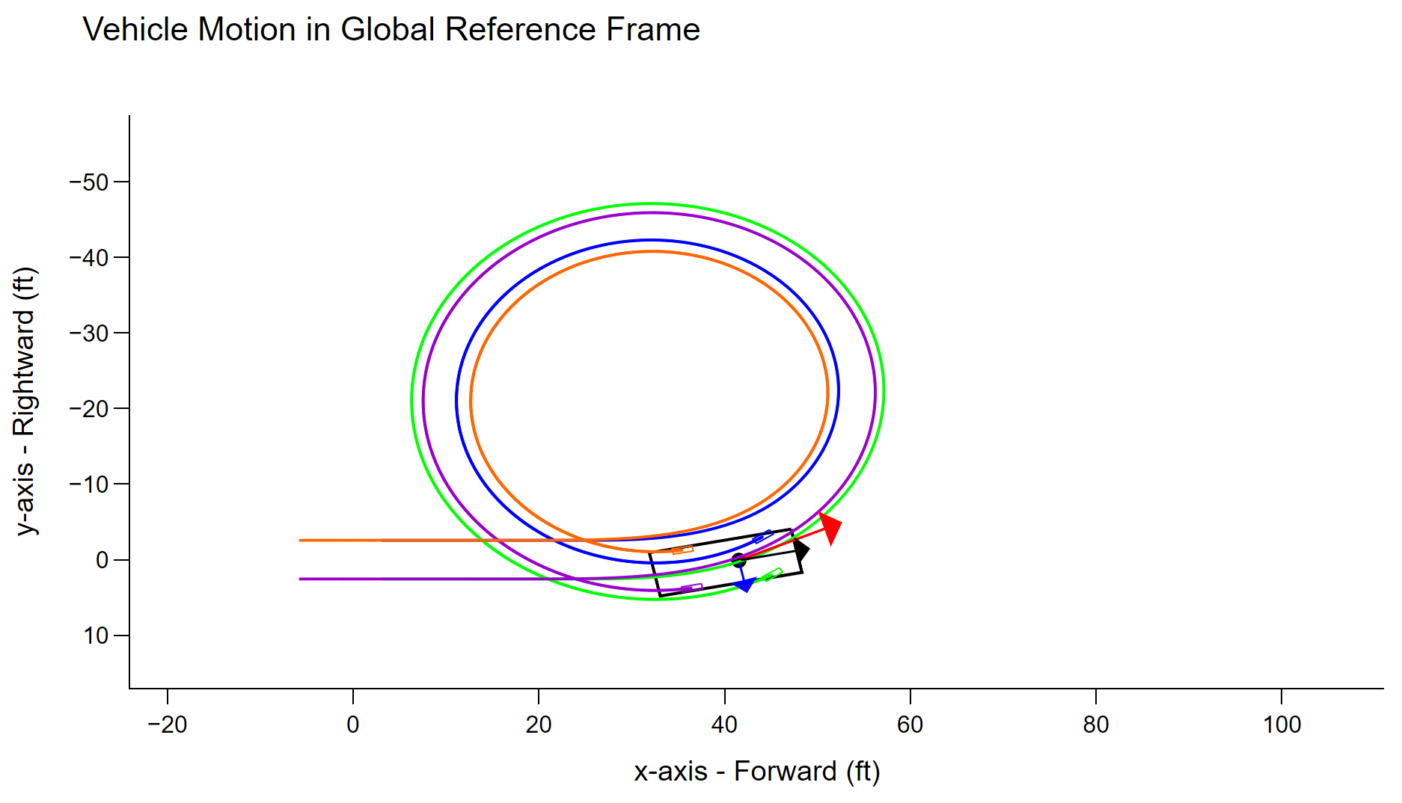

Slide 4
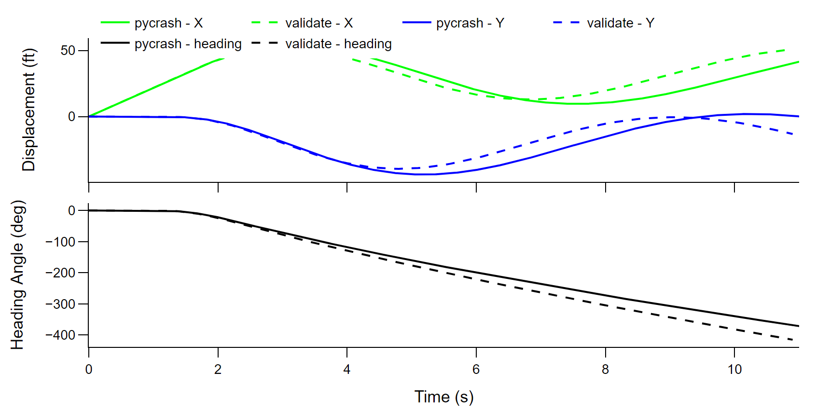

Slide 5
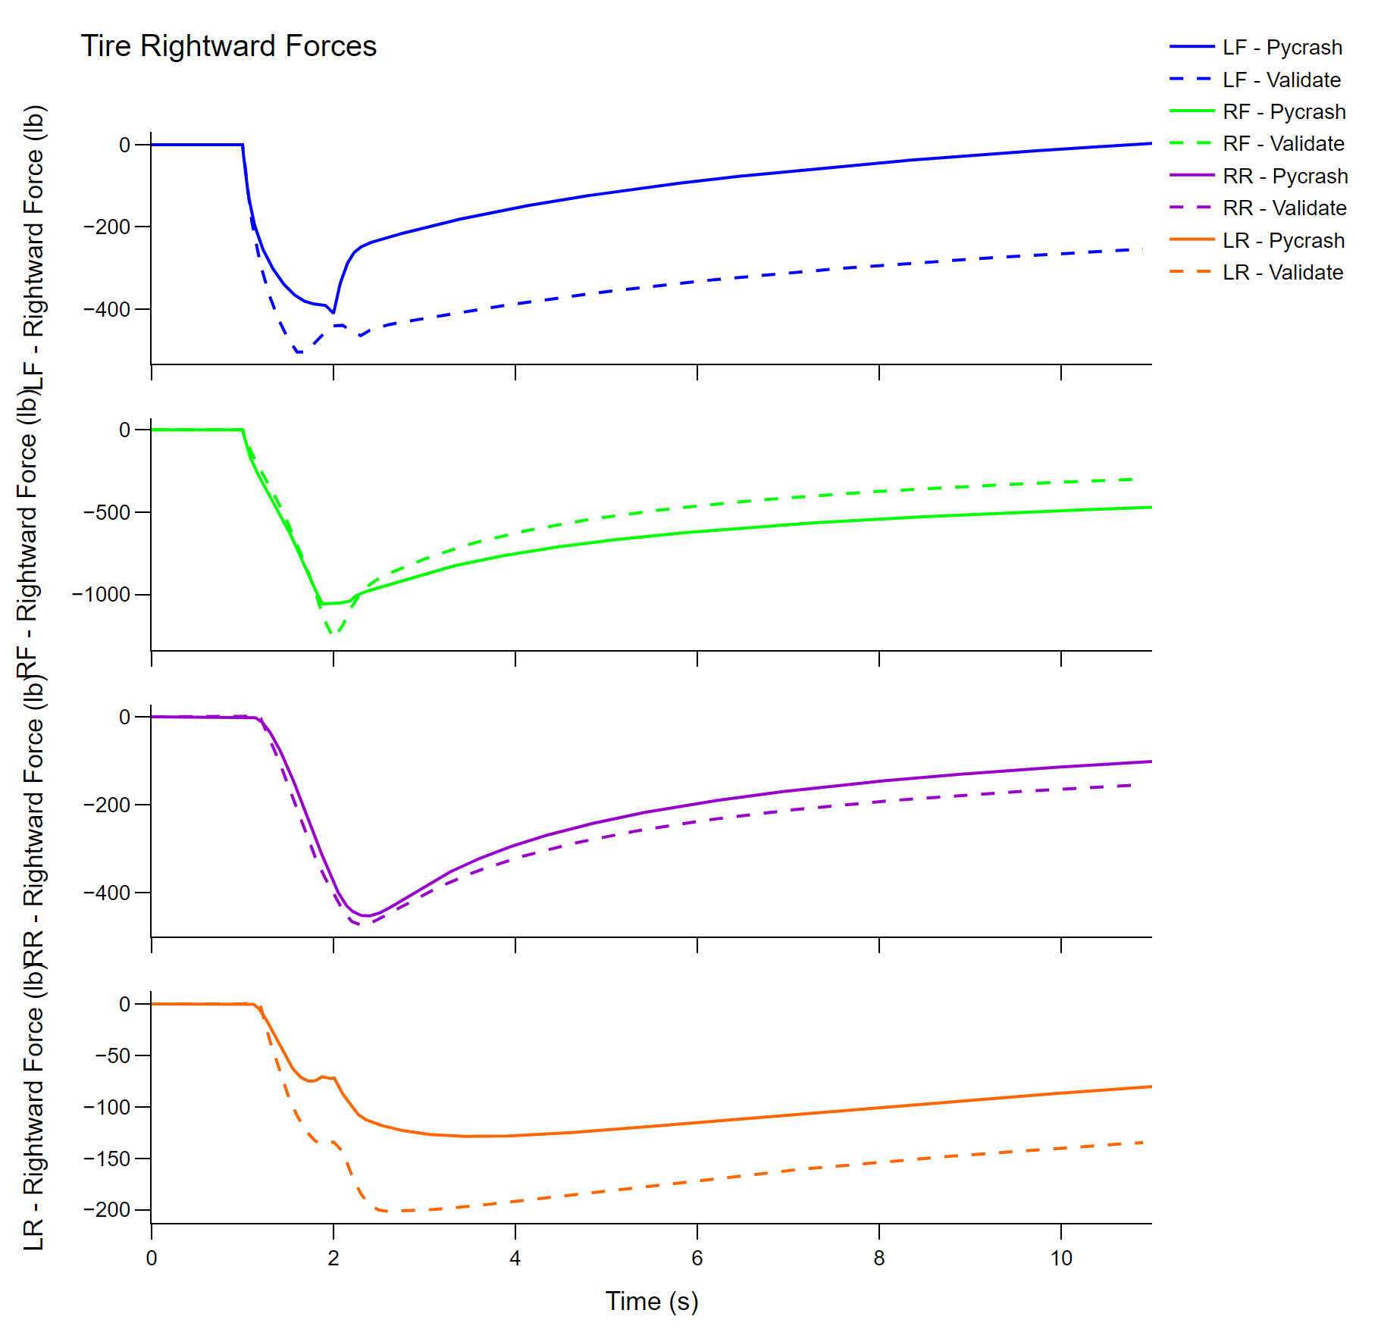

Slide 6
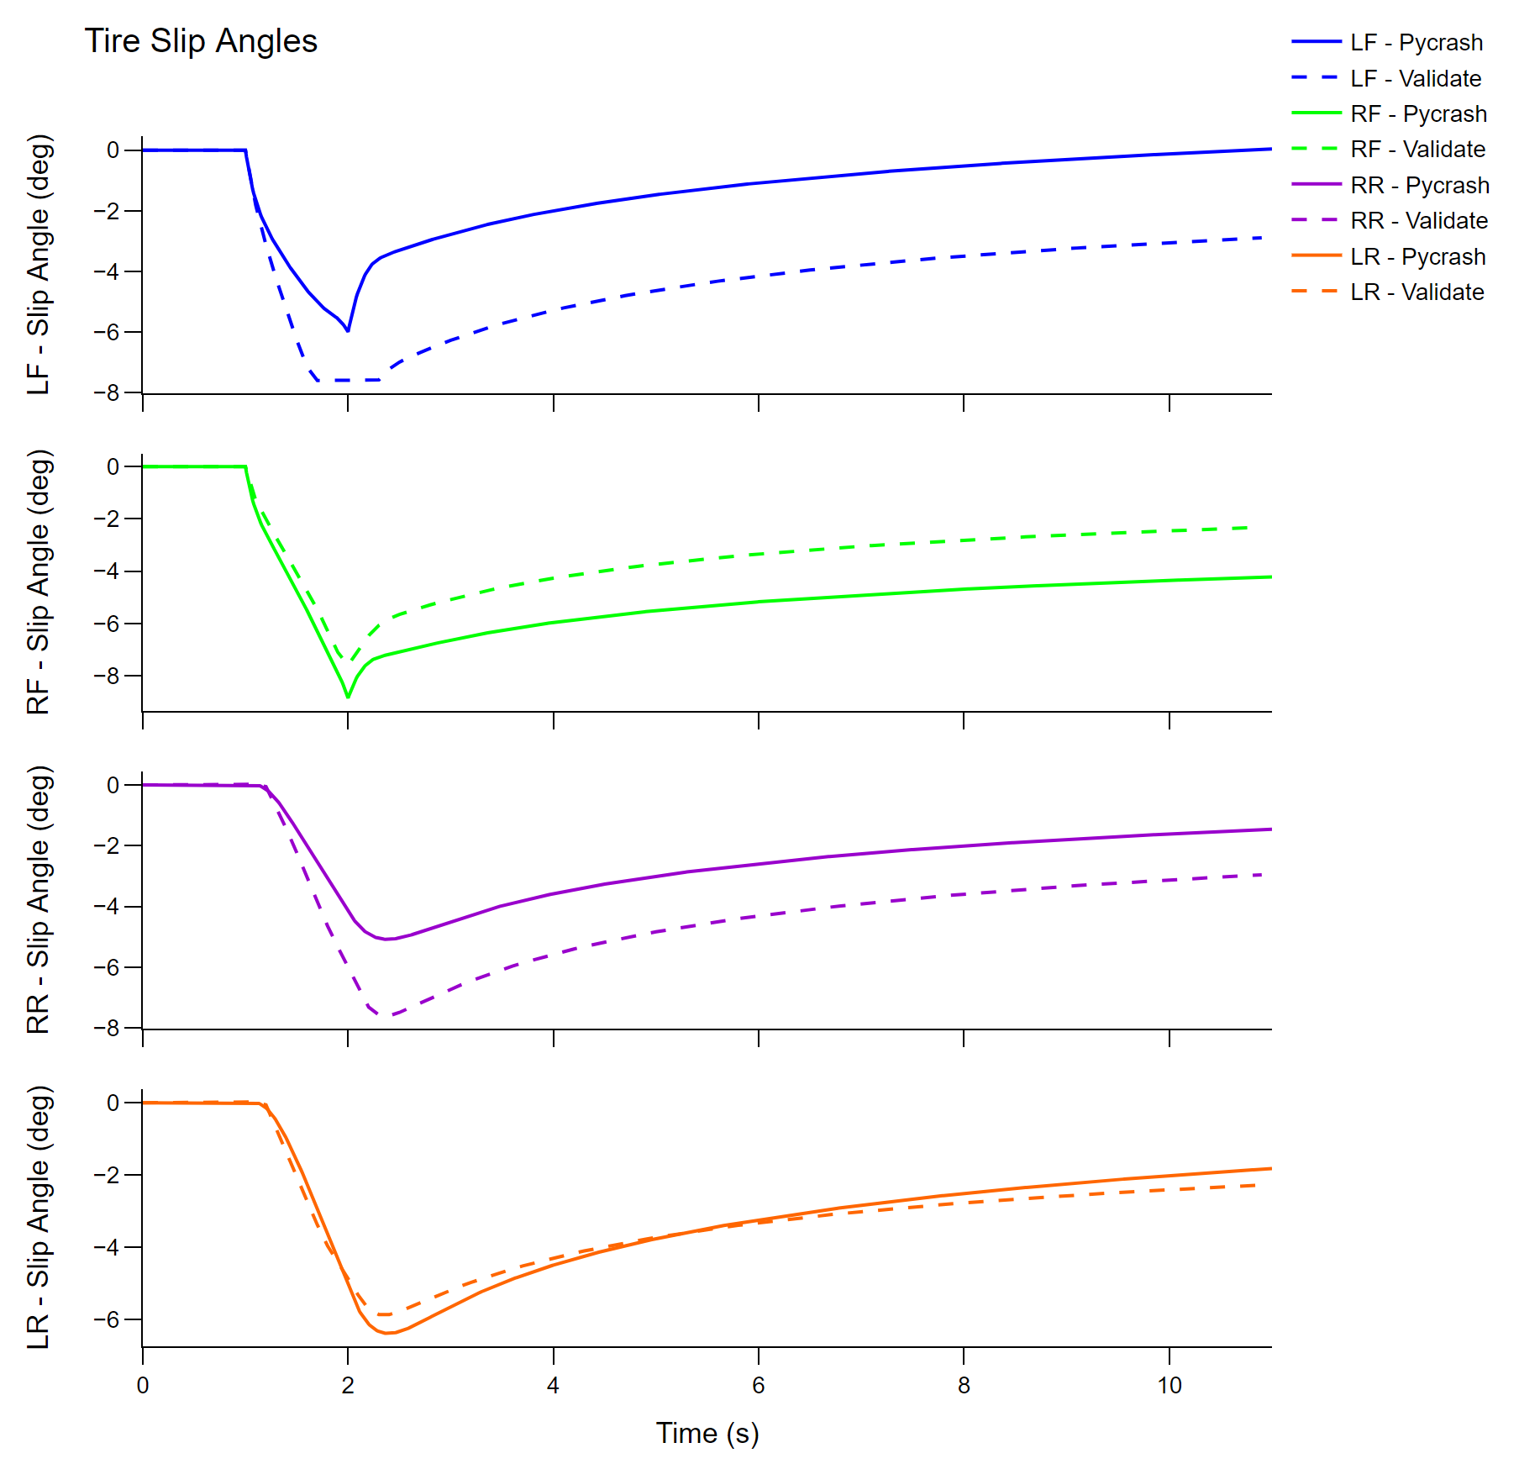

Slide 7
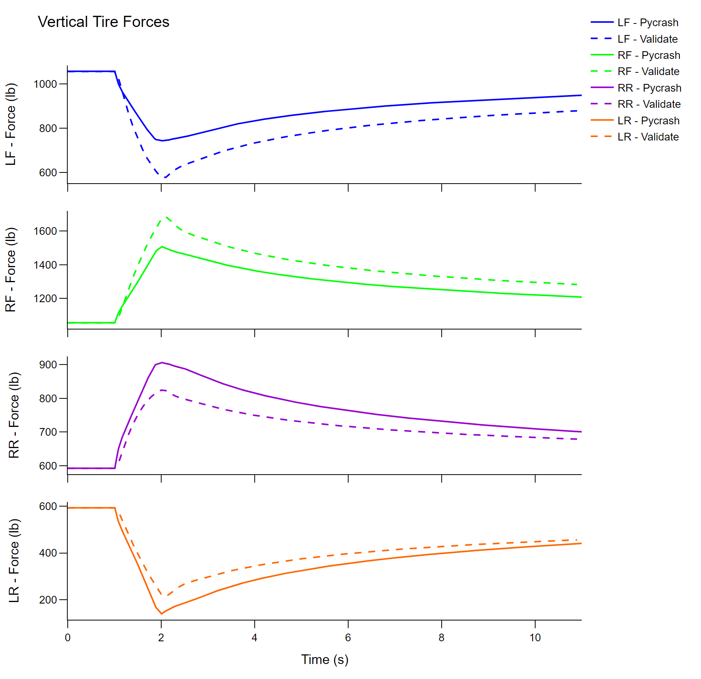

Slide 8
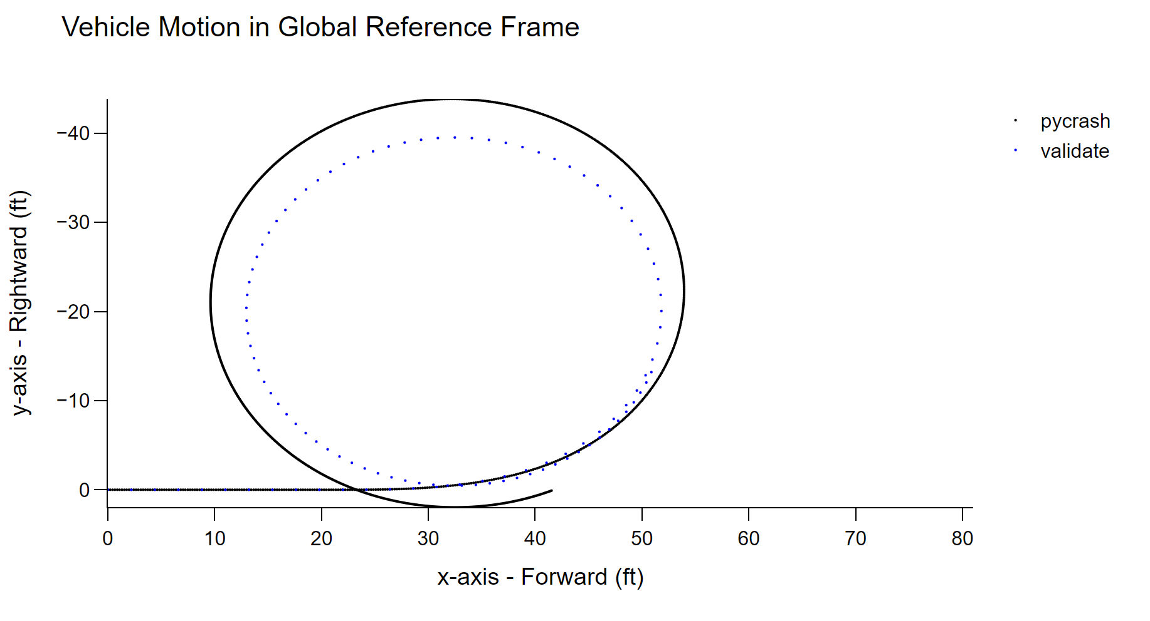

Slide 9
PC Crash – 15 mph Steer Comparison
PC Crash – No CG Height
Pycrash CG height = 0

Slide 10
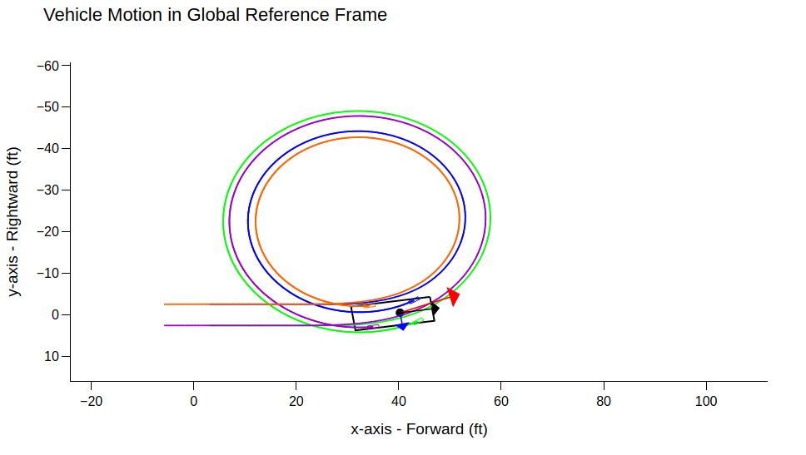
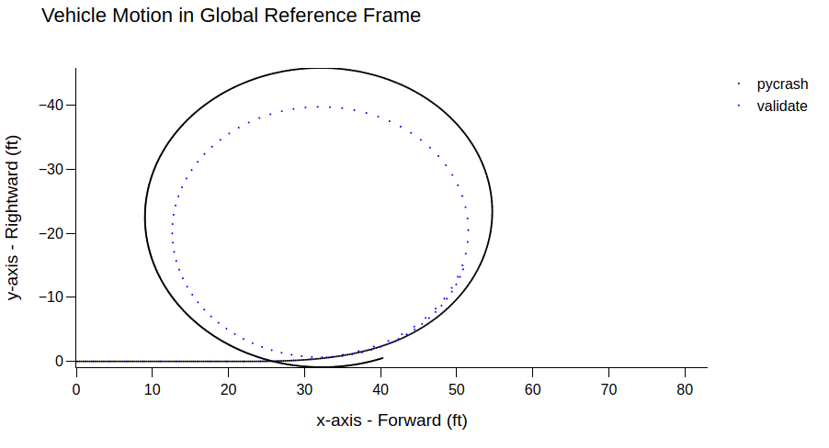

Slide 11
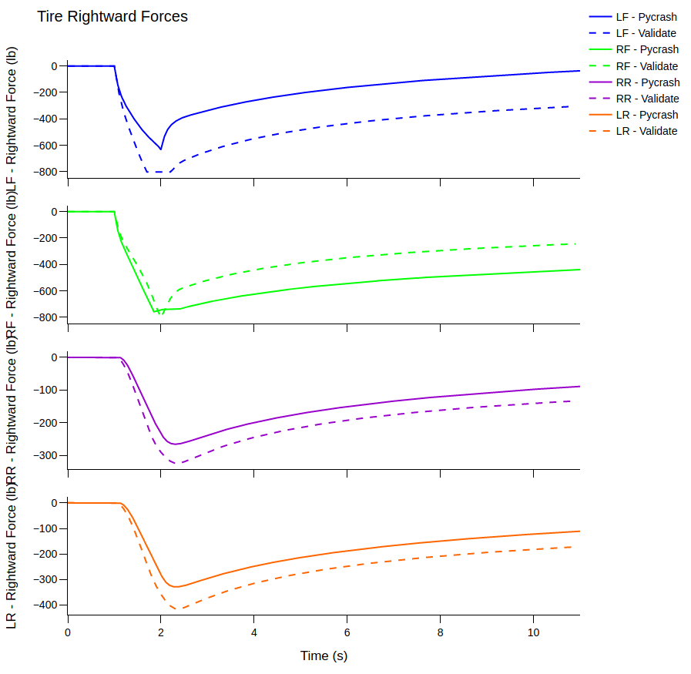
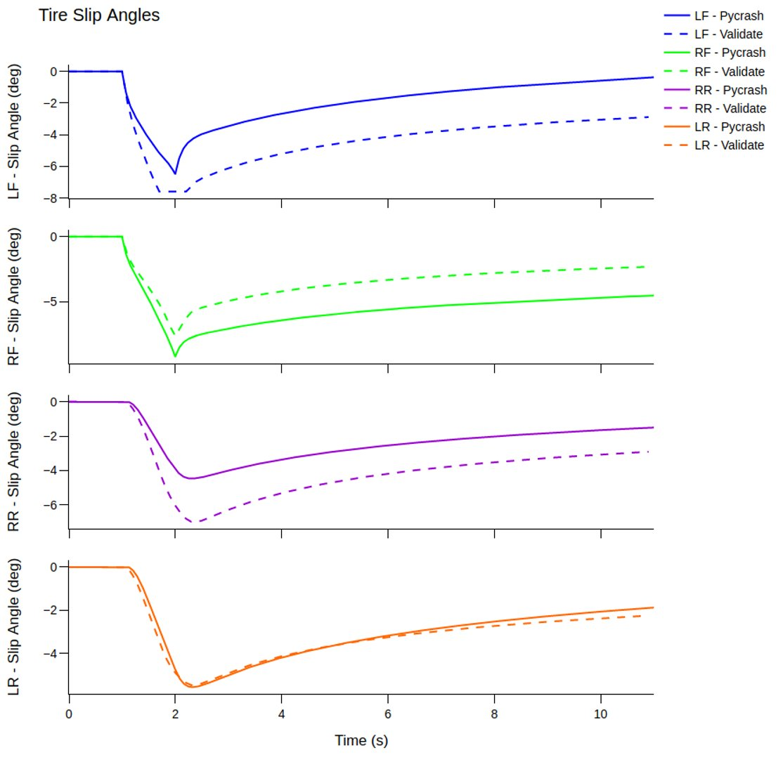

Slide 12
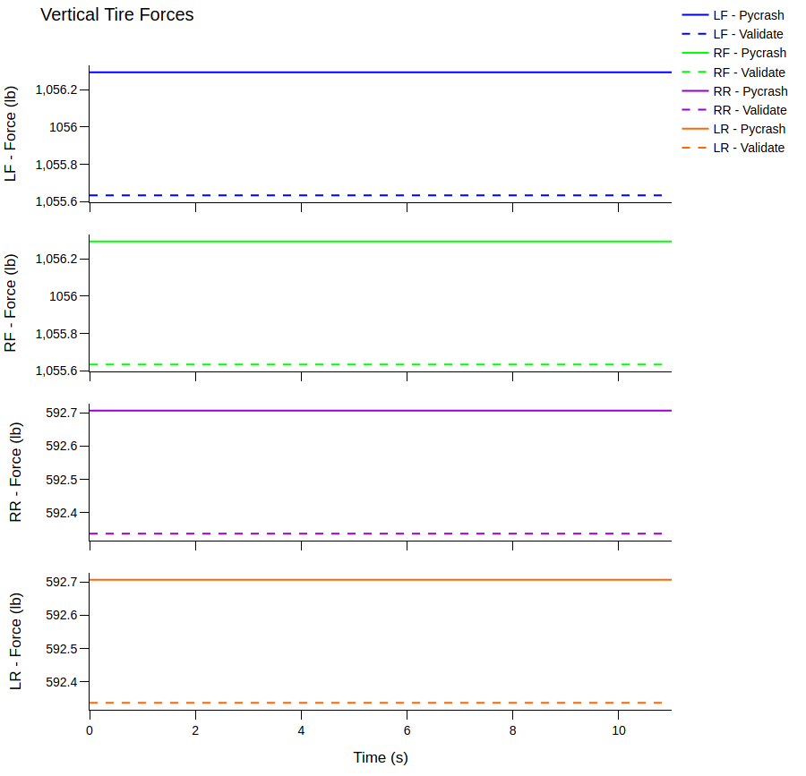

Slide 13
PC Crash – 15 mph Steer Comparison
PC Crash – Rigid Suspension
Pycrash CG height = 0 ft

Slide 14
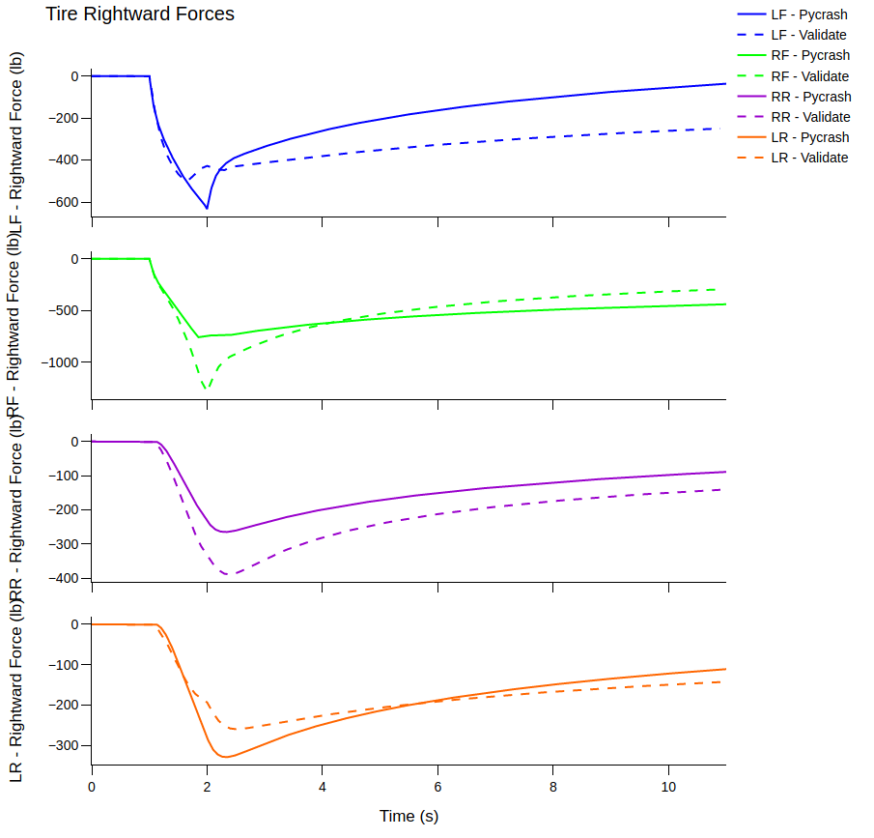
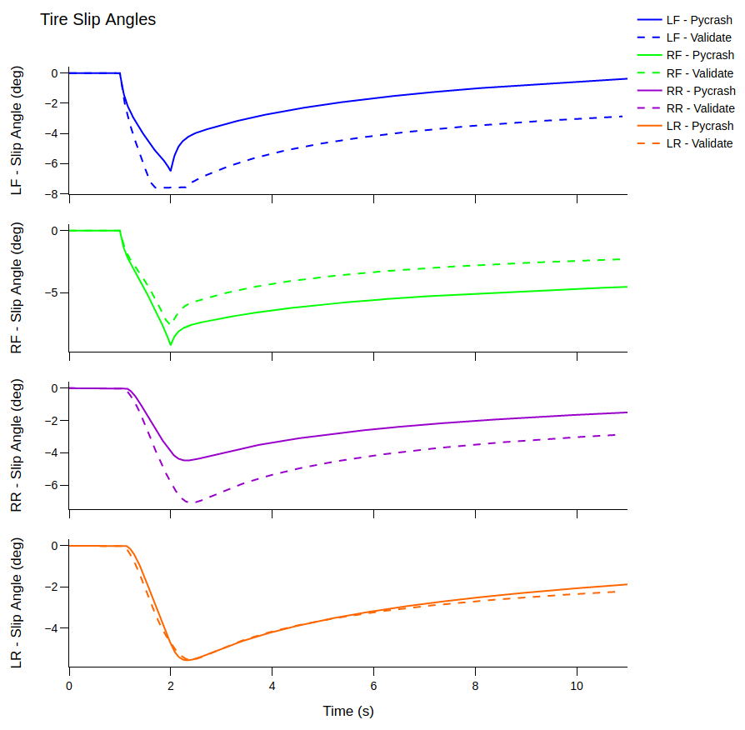

Slide 15
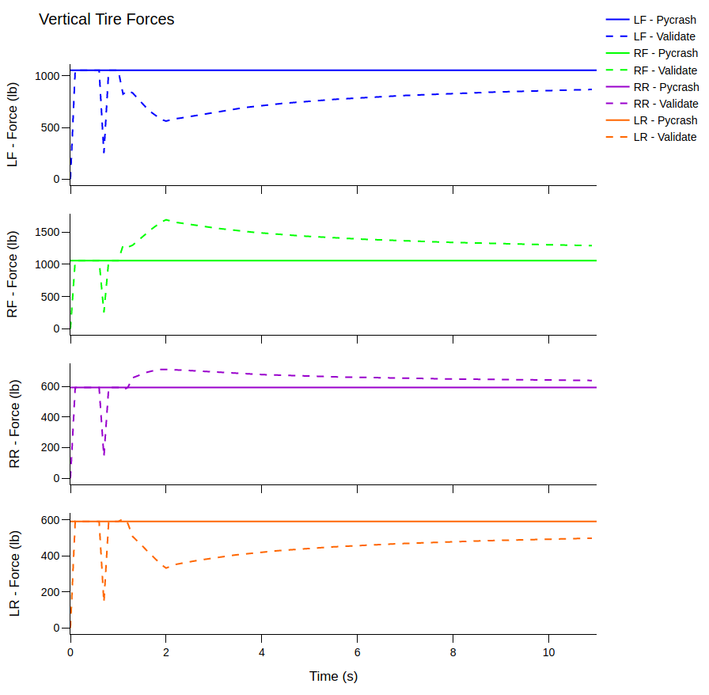

Slide 16
lateral force when tire is not saturated:
slip angle
mu max (0.76)
Lateral force =
Vertical force
alpha max (max slip angle x mu max)
max slip angle = 10 degrees

